Slide 1
DATA SCIENCE JOB SALARY ANALYSIS ON 2024
- SHIVANI T(23BDS042)

Slide 2
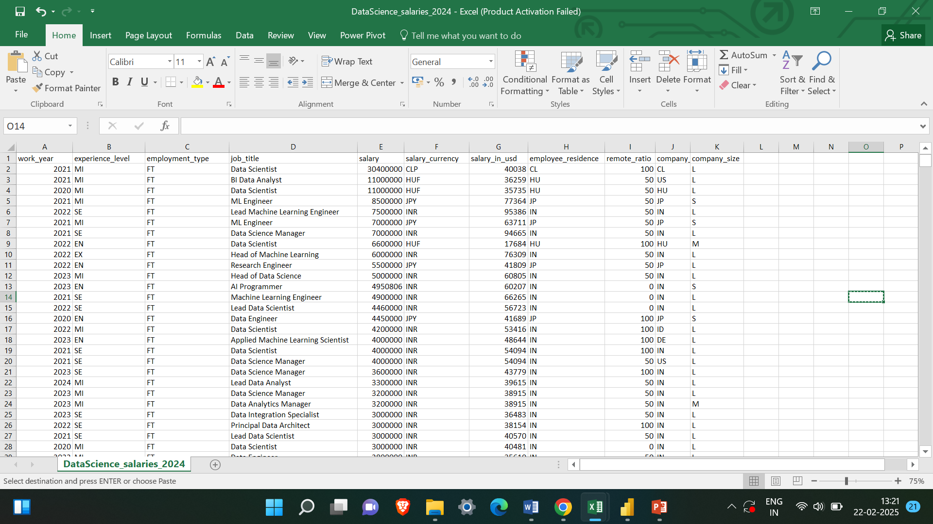
TRANSFORMATION AND CLEANING:

Slide 3
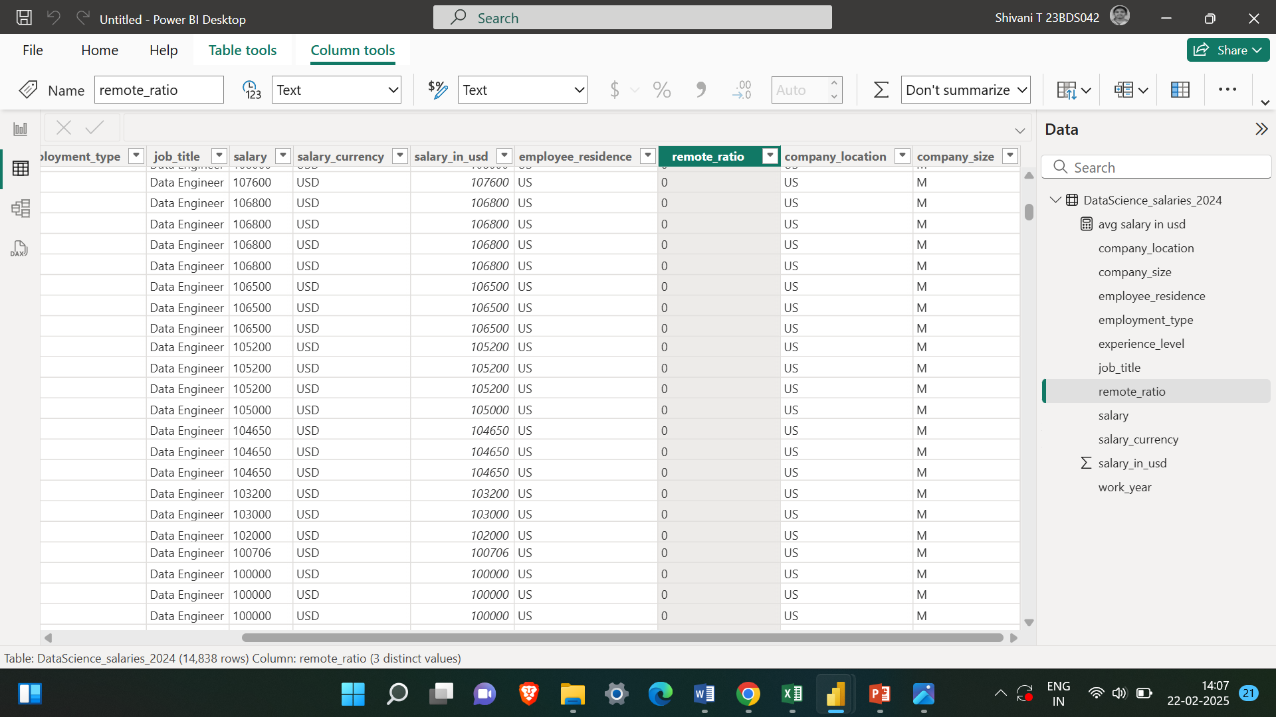
DAX
avg salary in usd = CALCULATE(AVERAGE(DataScience_salaries_2024[salary_in_usd]))

Slide 4
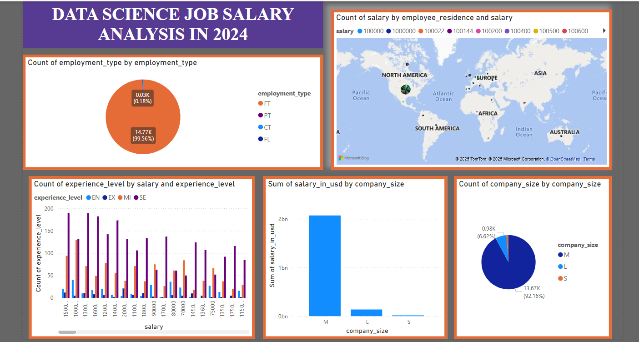

Slide 5
